Slide 1
CHAPTER : FIVE
Learning Agents

Slide 2
  Introduction
Artificial Intelligence (AI) is concerned with programming computers to perform tasks that are presently done better by humans.
AI is about human behavior, the discovery of techniques that will allow computers to learn from humans.
One of the most often heard criticisms of AI is that machines cannot be called Intelligent until they are able to learn to do new things and adapt to new situations, rather than simply doing as they are told to do.
There can be little question that the ability to adapt to new surroundings and to solve new problems is an important characteristic of intelligent entities.

Slide 3
What is Learning?
In the psychology literature, learning is considered one of the keys to human intelligence.
what learning is? Learning is:
  Memorizing something
  Knowing facts through observation and exploration
  Improving motor and/or cognitive skills through practice
The idea behind learning is that percepts should not only be used for acting now, but also for improving the agent’s ability to act in the future.
  Learning is essential for unknown environments, i.e. when designer lacks omniscience. It enables to organize new knowledge into general, effective representations
  Learning modifies the agent's decision making mechanisms to improve performance

Slide 4
  Cont……..Learning
Learning can be described as normally a relatively permanent change that occurs in behavior as a result of experience.
Learning occurs in various regimes, for example: -
It is possible to learn to open a lock as a result of trial and error.
It is possible to learn how to use a word processor as a result of following particular instructions.
There’s no decisive definition of learning, but here are some that do justice: -
“Learning denotes changes in a system that ... enables a system to do the same task more efficiently the next time.” Herbert Simon
“Learning is constructing or modifying representations of what is being experienced.” Ryszard Michalski
“Learning is making useful changes in our minds.” Marvin Minsky
The idea behind learning is that percepts should be used not only for acting, but also for improving the agent's ability to act in the future.
Learning takes place as the agent observes its interactions with the world and its own decision-making processes.

Slide 5
  Machine Learning
The goal of machine learning is to build computer systems that can learn from their experience and adapt to their environments.
Obviously, learning is an important aspect or component of intelligence.
Why Machine Learning?
One response to the idea of AI is to say that computers cannot think because they only do what their programmers tell them to do.
However, it is not always easy to tell what a particular program will do, but given the same inputs and conditions it will always produce the same outputs.
If the program gets something right once, it will always get it right and if it makes a mistake once it will always make the same mistake every time it runs.
Also, humans are able to notice similarities between things and therefore can generate new ideas about the world we live in.
So, machine learning is a prerequisite for any mature program of artificial intelligence.

Slide 6
  Three Phases of Machine Learning
  Machine Learning follows three phases, these are: -
Phase I: Training
A training set of examples of correct behavior is analyzed and some representation of the newly learnt knowledge is stored.
This is often some form of rules.
Phase II: Validation
The rules are checked and if necessary, additional training is given. Sometimes additional test data are used.
But instead of using a human to validate the rules, some other automatic knowledge-based component may be used.
The role of tester is often called the critic.
Phase III: Application
The rules are used in responding to some new situations.

Slide 7
  Learning Techniques
Rote Learning
In this kind of learning there is no prior knowledge.
When a computer stores a piece of data, it is performing an elementary form of learning.
Examples of correct behavior are stored and when a new situation arises it is matched with the learnt examples.
The values are stored so that they are not re-computed later. One of the earliest game-playing programs is Checkers Program (Samuel, 1963). This program learned to play checkers well enough to beat its creator/designer.
Deductive Learning
Deductive learning works on existing facts and knowledge and deduces new knowledge from the old.
This is best illustrated in the following example: -
Example: Assume, A = B and B = C, then we can deduce with much confidence that C = A.

Slide 8
Deductive learning does not generate “new” knowledge at all, it simply memorizes the logical consequences of what is known already.
This implies that virtually all mathematical research would not be classified as learning “new” things.
However, regardless of whether this is termed as new knowledge or not, it certainly makes the reasoning system more efficient.
Inductive Learning (Learning from Observations)
Inductive learning takes examples and generalizes rather than starting with existing knowledge.
For example, having seen many cats, all of which have tails, one might conclude that all cats have tails.
There is scope of error in inductive reasoning, but still it is a useful technique that has been used as the basis of several successful systems.

Slide 9
  Learning: Symbol-Based
Our world is a world of symbols.
We use symbolic interpretations to understand the world around us.
For instance, if we saw a ship and were to tell a friend about its size, we will not say that we saw a 254 meters long ship, instead we’d say that we saw a “huge” ship about the size of “Our Building”.
And our friend would understand the relationship between the size of the ship and its hugeness with the analogies of the symbolic information associated with the two words used: “huge” and “Our Building”.
Similarly, the techniques we are to learn now use symbols to represent knowledge and information. Let us consider a small example to help us see where we’re headed.
Example: What if we were to learn the concept of a GOOD STUDENT.
We would need to define, first of all some attributes of a student, on the basis of which we could tell apart the good student from the average.

Slide 10
Then we would require some examples of good students and average students.
To keep the problem simple, we can label all the students who are “not good” (Average, Below Average, Satisfactory, Bad) as NOT GOOD STUDENT.
Let’s say we choose two attributes to define a student, Grade and Class Participation. Both attributes can have either of the two values, High or Low.
Now from the above Student concept, the learner program might look like: -
Student (GOOD STUDENT): Grade (High) ∧ Class Participation (High)
Student (GOOD STUDENT): Grade (High) ∧ Class Participation (Low)
Student (NOT GOOD STUDENT): Grade (Low) ∧ Class Participation (High)
Student (NOT GOOD STUDENT): Grade (Low) ∧ Class Participation (Low)

Slide 11
As you can see the system is composed of symbolic information, based on which the learner can even generalize that a student is a GOOD STUDENT if his/her grade is High, even if the class participation is Low.
Student (GOOD STUDENT): Grade (High) ∧ Class Participation (?)
This is the final rule that the learner has learnt from the enumerated examples.
Here the “?” means that the attribute class participation can have any value, as long as the grade is High.

Slide 12








Face Recognition
Learning: it is training (adaptation) from data set
Training examples of a person –
Test images

Slide 13
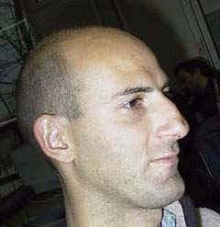
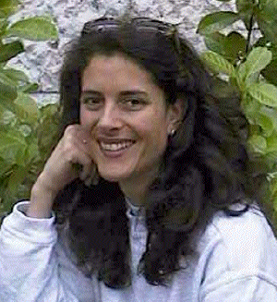
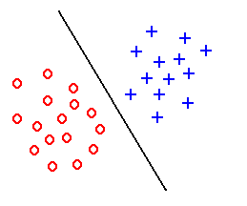
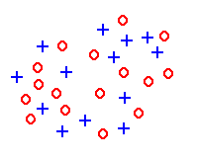
Feature extraction
x =
Hair length y =0
x =
Hair length y = 30 cm
Task: to extract features which are good for classification.
Good features:
Objects from the same class have similar feature values.
Objects from different classes have different values.
“Good” features
“Bad” features

Slide 14
The Basic Learning Model
A computer program is said to learn from experience E with respect to some class of tasks T and performance measure P,
  if its performance at tasks T, as measured by P, improves with experience E.
Learning agents consist of four main components:
  learning element -- the part of the agent responsible for improving its performance
  performance element -- the part that chooses the actions to take
  critic – provides feedback for the learning element how the agent is doing with respect to a performance standard
  problem generator -- suggests actions that could lead to new, informative experiences (suboptimal from the point of view of the performance element, but designed to improve that element)

Slide 15
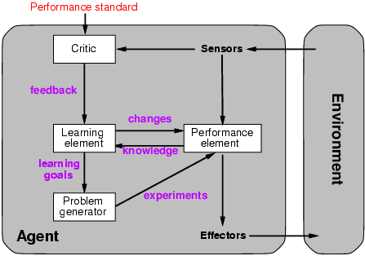
Learning Agents

Slide 16
Types of learning
Supervised learning: occurs where a set of input/output pairs are explicitly presented to the agent by a teacher
  The teacher provides a category label for each pattern in a training set, then the learning algorithm finds a rule that does a good job of predicting the output associated with a new input.
Unsupervised learning: Learning when there is no information about what the correct outputs are.
  In unsupervised learning or clustering there is no explicit teacher, the system forms clusters or natural groupings of the input patterns.

Slide 17
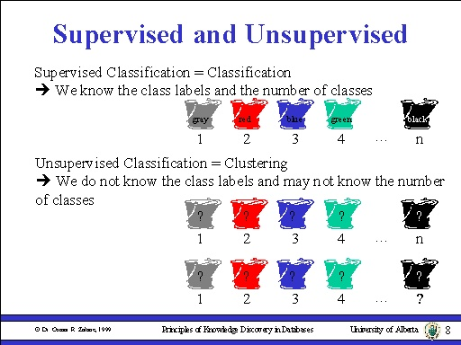

Slide 18
The Learning Problem
Given <x,f(x)> pairs, infer f
x | f(x)
1 | 1
2 | 4
3 | 9
4 | 16
5 | ?
Given a finite sample, it is often
impossible to guess the true function f.
Approach: Find some pattern (called a hypothesis) in the training examples, and assume that the pattern will hold for future examples too.

Slide 19
Data sets preparation for learning
Training set
  Used in supervised learning, a training set is a set of problem instances (described as a set of properties and their values), together with a classification of the instance.
Test set
  A set of instances and their classifications used to test the accuracy of a learned hypothesis.
Learning—A Two-Step Process
  Model construction: The training set is used to create the model. The model is represented as classification rules, decision trees, or mathematical formulae
  Model usage: the test set is used to see how well it works for classifying future or unknown objects

Slide 20



Step 1: Model Construction
Classification
Algorithms
Training
Data
Classifier
(Model)
IF rank = ‘professor’
OR years > 6
THEN tenured = ‘yes’

Slide 21




Step 2: Using the Model in Prediction
Classifier
model
Testing
Data
Unseen Data
(Jeff, Professor, 4)
Tenured?

Slide 22
Learning methods
There are various learning methods. Popular learning techniques include the following.
  Decision tree : divide decision space into piecewise constant regions.
  Neural networks: partition by non-linear boundaries
  Bayesian network: a probabilistic model
  Regression: (linear or any other polynomial)
  Support vector machine
  Expectation maximization algorithm

Slide 23
Decision tree
Decision tree performs classification by constructing a tree based on training instances with leaves having class labels.
  The tree is traversed for each test instance to find a leaf, and the class of the leaf is the predicted class. This is a directed knowledge discovery in the sense that there is a specific field whose value we want to predict.
Widely used learning method. It has been applied to:
  classify medical patients based on the disease,
  equipment malfunction by cause,
  loan applicant by likelihood of payment.
Easy to interpret: can be re-represented as if-then-else rules
Does not require any prior knowledge of data distribution, works well on noisy data.

Slide 24
Decision Trees
Tree where internal nodes are simple decision rules on one or more attributes and leaf nodes are predicted class labels; i.e. a Boolean classifier for the input instance.
        Given an instance of an object or situation, which is specified by a set of properties, the tree returns a "yes" or "no" decision about that instance.
Attribute_1
value-1
value-3
value-2
Attribute_2
Class1
Attribute_2
value-5
value-4
value-6
Value-7
Class2
Class3
Class4
Class5

Slide 25
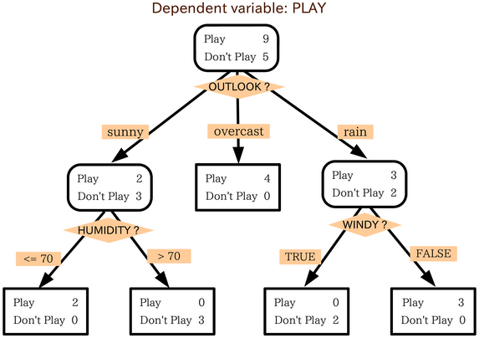
Decision trees

Slide 26
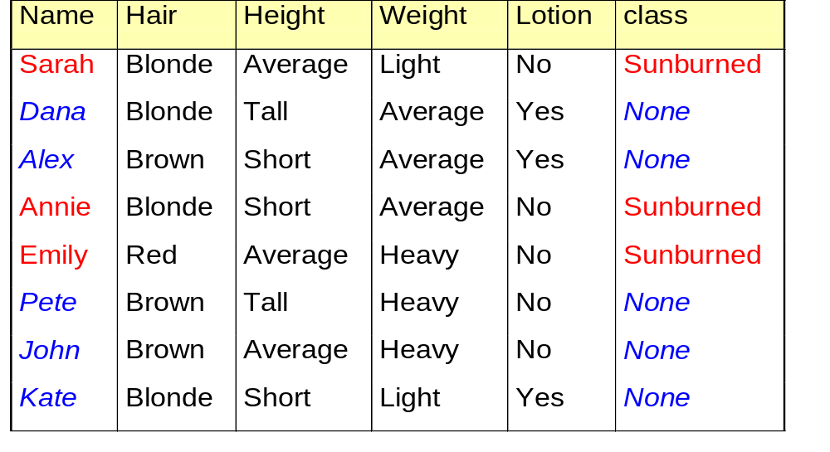
Example 1: The problem of “Sunburn”
You want to predict whether another person is likely to get sunburned if he is back to the beach. How can you do this?
Data Collected: predict based on the observed properties of the people
Notes:
You might hope that the new person would be an exact match to one of the examples in the table. What are the chances of this?
Actually there are 3 x 3 x 3x 2 = 54 possible combinations of attributes. Eight examples so chance of an exact match for a randomly chosen example is 8/54=0.15
Not good. In general there would be many more factors or attributes and each might take many values.

Slide 27
Decision Tree 1
This is one way of looking at the data, starting with ‘Height’ property. The decision tree correctly CLASSIFIES all the data!
is_sunburned
Height
short
tall
average
Hair colour
Weight
Dana, Pete
blonde
red
brown
light
average
heavy
Alex
Sarah
Weight
Hair colour
blonde
light
average
heavy
red
brown
Emily
John
Katie
Annie

Slide 28
Decision Tree 2
Is there any attributes you don’t like to use for predicting whether people will suffer from sunburn? Of course it isn’t reasonable to use height.
is_sunburned
Lotion used
no
yes
Hair colour
Hair colour
blonde
blonde
red
brown
red
brown
Sarah, Annie
Dana, Katie
Emily
Pete, John
Alex
This decision tree is a lot better than the first one and it doesn’t involve any of the irrelevant attributes. Unfortunately though it uses the hair colour attribute twice which doesn’t seem so efficient.

Slide 29
The best decision tree?
is_sunburned
Hair colour
blonde
red
brown
?
Emily
Alex
Pete
John
Sunburned = Sarah, Annie,
None = Dana, Katie
Once we have finished with hair colour we then need to calculate the remaining branches of the decision tree.
Which attributes is better to classify the remaining ?
Notes:
Once we have finished with hair colour we then need to calculate the remaining branches of the decision tree.
The examples corresponding to that branch are now the total set and no reference is made to the whole set of examples.
One just applies the same procedure as before with JUST those examples (i.e. the blondes).
This is left as an exercise for you on the exercise sheet.

Slide 30
The best Decision Tree
This is the simplest and optimal one possible and it makes a lot of sense.
It classifies 4 of the people on just the hair colour alone.
is_sunburned
Hair colour
blonde
brown
red
Alex,
Pete,
John
Emily
Lotion used
no
yes
Sarah, Annie
Dana,
Katie

Slide 31
Sunburn sufferers are ...
You can view Decision Tree as an IF-THEN_ELSE statement which tells us whether someone will suffer from sunburn.
If (Hair-Colour=“red”) then
    return (sunburned = yes)
    else if (hair-colour=“blonde” and lotion-used=“No”) then
    return (sunburned = yes)
  else
  return (false)
Notes:
Is there anything you don’t like about this this program for predicting whether people will suffer from sunburn?
It is all perfectly reasonable?
Of course it isn’t reasonable at all. We KNOW that height is IRRELEVANT for determining whether someone will suffer from sunburn.
Well, what I mean is that there are much MORE relevant decision variables to use.
Now I want you to draw a new decision diagram that makes a bit more sense. I ‘ll give you five minutes.

Slide 32
Example: Wait for a Table at a Restaurant
Problem: decide whether to wait for a table at a restaurant, based on the following attributes:
  Alternate: is there an alternative restaurant nearby?
  Bar: is there a comfortable bar area to wait in?
  Fri/Sat: is today Friday or Saturday?
  Hungry: are we hungry?
  Patrons: number of people in the restaurant (None, Some, Full)
  Price: price range ($, $$, $$$)
  Raining: is it raining outside?
  Reservation: have we made a reservation?
  Type: kind of restaurant (French, Italian, Thai, Burger)
  WaitEstimate: estimated waiting time (0-10, 10-30, 30-60, >60)

Slide 33
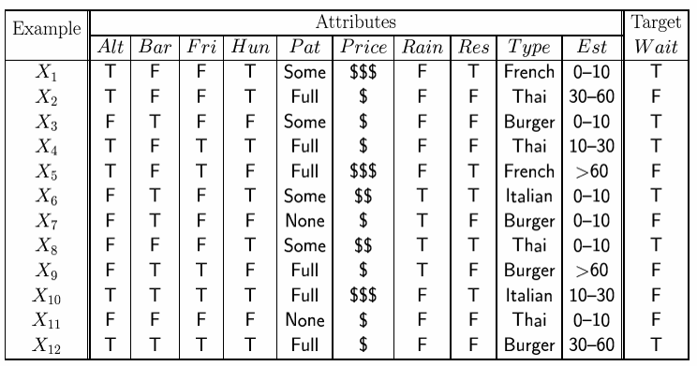
Attribute-based representations
Examples described by attribute values (Boolean, discrete, continuous)
E.g., situations where I will/won't wait for a table:
Classification of examples is positive (T) or negative (F)

Slide 34
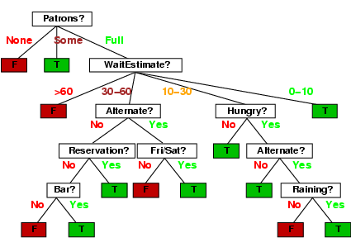
Learning Decision trees 1
One possible representation for hypotheses
E.g., here is the “true” tree for deciding whether to wait:

Slide 35
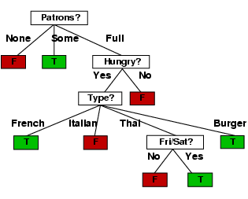
Learning decision trees 2
Decision tree learned from the 12 examples:
Substantially simpler than “true” tree---a more complex hypothesis isn’t justified by small amount of data

Slide 36
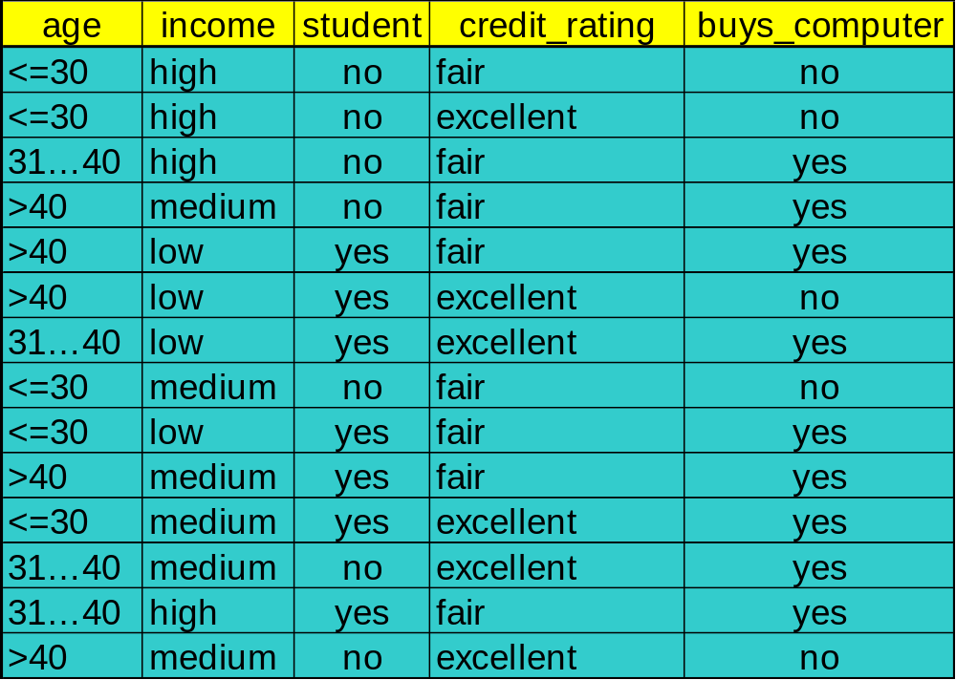
Exercise: Decision Tree for “buy computer or not”. Use the training Dataset given below to construct decision tree

Slide 37
Output: A Decision Tree for “buys_computer”
age?
<=30
overcast
>40
31..40
student?
yes
credit rating?
no
yes
excellent
fair
no
yes
no
yes

Slide 38
Pros and Cons of decision trees
Pros
Reasonable training time
Fast application
Easy to interpret
Easy to implement
Can handle large
number of features
Cons
Cannot handle complicated
relationship between features
simple decision boundaries
problems with lots of missing
data
Why decision tree induction in data mining?
relatively faster learning speed (than other classification methods)
convertible to simple and easy to understand classification rules
comparable classification accuracy with other methods

Slide 39
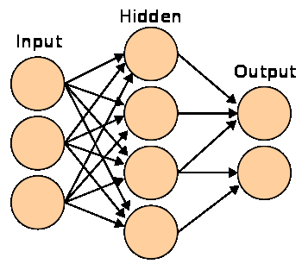
Neural Network
It is represented as a layered set of interconnected processors. These processor nodes has a relationship with the neurons of the brain. Each node has a weighted connection to several other nodes in adjacent layers. Individual nodes take the input received from connected nodes and use the weights together to compute output values.
The inputs are fed simultaneously into the input layer.
The weighted outputs of these units are fed into hidden layer.
The weighted outputs of the last hidden layer are inputs to units making up the output layer.

Slide 40
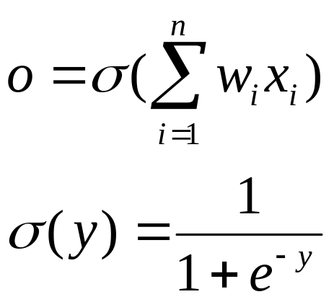
Architecture of Neural network
Neural networks are used to look for patterns in data, learn these patterns, and then classify new patterns & make forecasts
A network with the input and output layer only is called single-layered network. Whereas, a multilayer neural network is a generalized one with one or more hidden layer.
  A network containing two hidden layers is called a three-layer neural network, and so on.
Single layered NN
Multilayer NN
x1
x1
w1
x2
x2
w2
x3
w3
x3
Output nodes
Input nodes
Hidden nodes

Slide 41
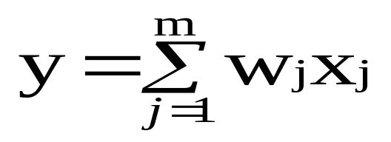
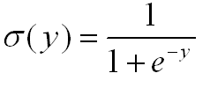
Hidden layer: Neuron with Activation
The neuron is the basic information processing unit of a NN. It consists of:
  1 A set of links, describing the neuron inputs, with weights W₁, W₂, …, W_{m}
  2. An adder function (linear combiner) for computing the weighted sum of the inputs (real numbers):
  3. Activation function : for limiting the output behavior of the neuron.

Slide 42
Topologies of neural network
In a feed forward neural network connections between the units do not form a directed cycle.
  In this network, the information moves in only one direction, forward, from the input nodes, through the hidden nodes (if any) and to the output nodes. There are no cycles or loops in the network.
In recurrent networks data circulates back and forth until the activation of the units is stabilized
  Recurrent networks have a feedback loop where data can be fed back into the input at some point before it is fed forward again for further processing and final output.
In a feed forward NN the data processing can extend over multiple (layers of) units, but no feedback connections are present, that is, connections extending from outputs of units to inputs of units in the same layer or previous layers.

Slide 43
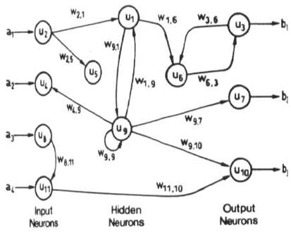

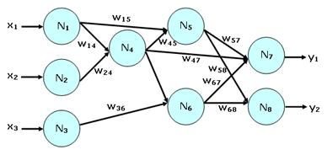
Topologies of neural network

Slide 44
Training the neural network
Back Propagation is the most commonly used method for training multilayer feed forward NN.
  Back propagation learns by iteratively processing a set of training data (samples).
  For each sample, weights are modified to minimize the error between the desired output and the actual output.
After propagating an input through the network, the error is calculated and the error is propagated back through the network while the weights are adjusted in order to make the error smaller.

Slide 45
Propagation through Hidden Layer
-
Bias Θj
x₀
w_{0j}
x₁
w_{1j}
∑
y
output y
x_{n}
w_{nj}
Input
vector x
weight
vector w
weighted
sum
Activation
function
The inputs to unit j are outputs from the previous layer. These are multiplied by their corresponding weights in order to form a weighted sum, which is added to the bias associated with unit j.
A nonlinear activation function f is applied to the net input.

Slide 46
Steps in Back propagation Algorithm
STEP ONE: initialize the weights and biases.
  The weights in the network are initialized to random numbers from the interval [-1,1].
  Each unit has a BIAS associated with it
  The biases are similarly initialized to random numbers from the interval [-1,1].
STEP TWO: feed the training sample.
STEP THREE: Propagate the inputs forward; we compute the net input and output of each unit in the hidden and output layers.
STEP FOUR: back propagate the error.
STEP FIVE: update weights and biases to reflect the propagated errors.
STEP SIX: terminating conditions.

Slide 47
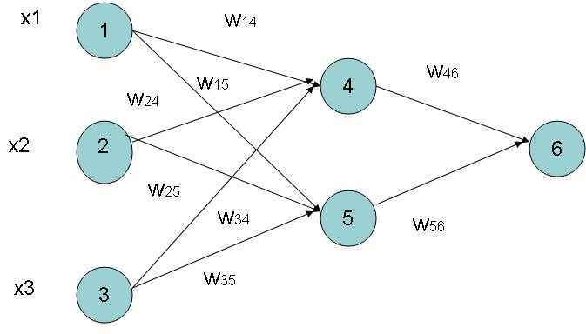
Example of Back propagation
Input = 3, Hidden Neuron = 2, Output =1
Initialize weights :
Random Numbers from -1.0 to 1.0
Initial Input and weight
x1 | x2 | x3 | w14 | w15 | w24 | w25 | w34 | w35 | w46 | w56
1 | 0 | 1 | 0.2 | -0.3 | 0.4 | 0.1 | -0.5 | 0.2 | -0.3 | -0.1

Slide 48
Pros and Cons of Neural Network
Useful for learning complex data like handwriting, speech and image recognition
Pros
Can learn more complicated
class boundaries
Fast application
Can handle large number of
features
Cons
Slow training time
Hard to interpret
Hard to implement: trial
and error for choosing
number of nodes
Neural Network needs long time for training.
Neural Network has a high tolerance to noisy and incomplete data
Conclusion: Use neural nets only if decision-trees fail.

